Slide 1
Project Presentation-I
Topic: Measures of central tendency &
Measures of Dispersion
By Samadhan Kale

Slide 2
Objectives
To understand deeply the topic.
To known specific formulae.
To understand the topic with examples.

Slide 3
Arithmetic Mean
For individual observations
A.M.=$\sum_{i=1}^{n}{\frac{xi}{n}}$ , n=number of observations
For individual observations
A.M.=∑24_(𝑖=1)^𝑛▒𝑥𝑖/𝑛 , n=number of observations
For discrete frequency distribution
A.M.=$\sum_{i=1}^{n}{\frac{fixi}{N}}$ , N=$\sum{fi}$
For discrete frequency distribution
A.M.=∑24_(𝑖=1)^𝑛▒𝑓𝑖𝑥𝑖/𝑁 , N=∑▒𝑓𝑖
For continuous frequency distribution
A.M.=$\sum_{i=1}^{n}{\frac{fixi}{N}}$ , N=$\sum{fi}$ & xi= Mid values of class interval
For continuous frequency distribution
A.M.=∑_(𝑖=1)^𝑛▒𝑓𝑖𝑥𝑖/𝑁 , N=∑▒𝑓𝑖 & xi= Mid values of class interval

Slide 4
Median
For individual observations
value of ${\left[\frac{n+1}{2}\right]}^{th}$ observation, n is odd.
value of [(𝑛+1)/2]^𝑡ℎ observation, n is odd.
Mean of middle two terms , n is even.
For discrete frequency distribution
value of ${\left[\frac{N}{2}\right]}^{th}$ observation, N=cumulative frequency
value of [𝑁/2]^𝑡ℎ observation, N=cumulative frequency
For continuous frequency distribution
$$l+\frac{\frac{N}{2}−c.f.}{f}×h$$
𝑙+(𝑁/2−𝑐.𝑓.)/𝑓×ℎ

Slide 5
Mode
For individual observations & discrete frequency distribution
Mo= obs. With max. frequency.
For continuous frequency distribution
Mo=$l+\frac{fm−f1}{2fm−f1−f2}×h$
For continuous frequency distribution
Mo=𝑙+(𝑓𝑚−𝑓1)/(2𝑓𝑚−𝑓1−𝑓2)×ℎ

Slide 6
Measures of Dispersions
Range
Quartile Deviation
Mean Deviation
Variance
Standard Deviation

Slide 7
Examples
Q.1) Find mean, median and mode of the following data:
→ 35,38,40,39,35,36,37
Mean= 37.143
Median=37
Mode=35
Q.2) Find mean , median and mode of the following.
Xi | 25 | 30 | 26 | 27 | 28 | 31 | 29
fi | 15 | 17 | 16 | 18 | 20 | 19 | 17

Slide 8
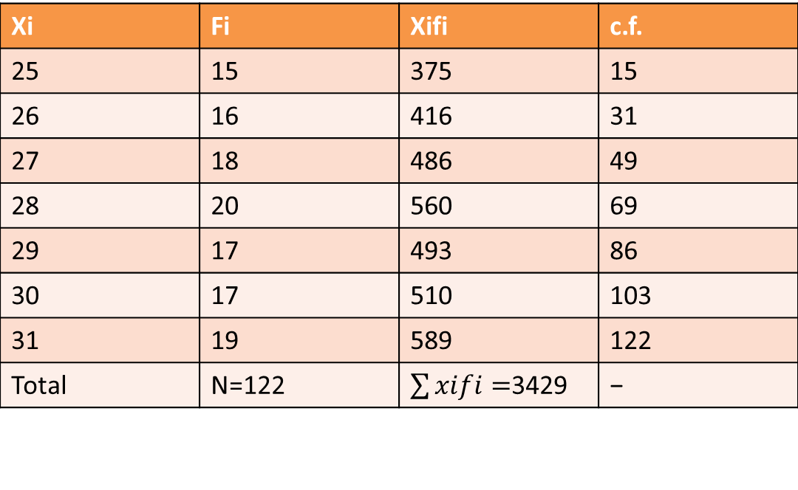
Solution
Xi | Fi | Xifi | c.f.
25 | 15 | 375 | 15
26 | 16 | 416 | 31
27 | 18 | 486 | 49
28 | 20 | 560 | 69
29 | 17 | 493 | 86
30 | 17 | 510 | 103
31 | 19 | 589 | 122
Total | N=122 | $\sum{xifi=}$3429 | −

Slide 9
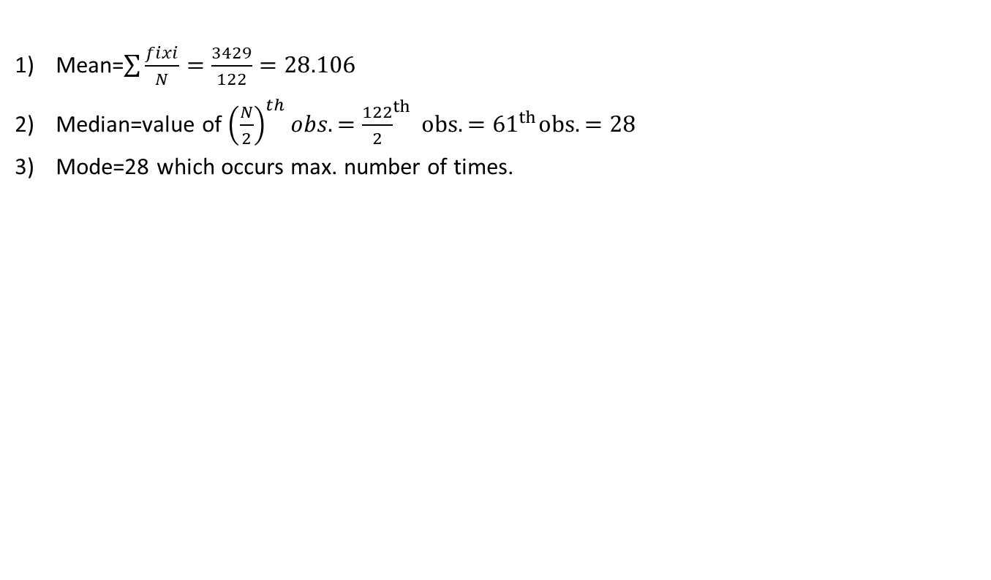
Continued
Mean=$\sum{\frac{fixi}{N}=\frac{3429}{122}=28.106}$
Median=value of ${\left(\frac{N}{2}\right)}^{th}obs.={\frac{122}{2}}^{th} obs.={61}^{th}obs.=28$
Mode=28 which occurs max. number of times.

Slide 10
Q.3) compute mean , median and mode for the following data.
Class | 2-6 | 6-10 | 10-14 | 14-18 | 18-22 | 22-26 | 26-30
frequency | 1 | 9 | 21 | 47 | 52 | 36 | 19

Slide 11
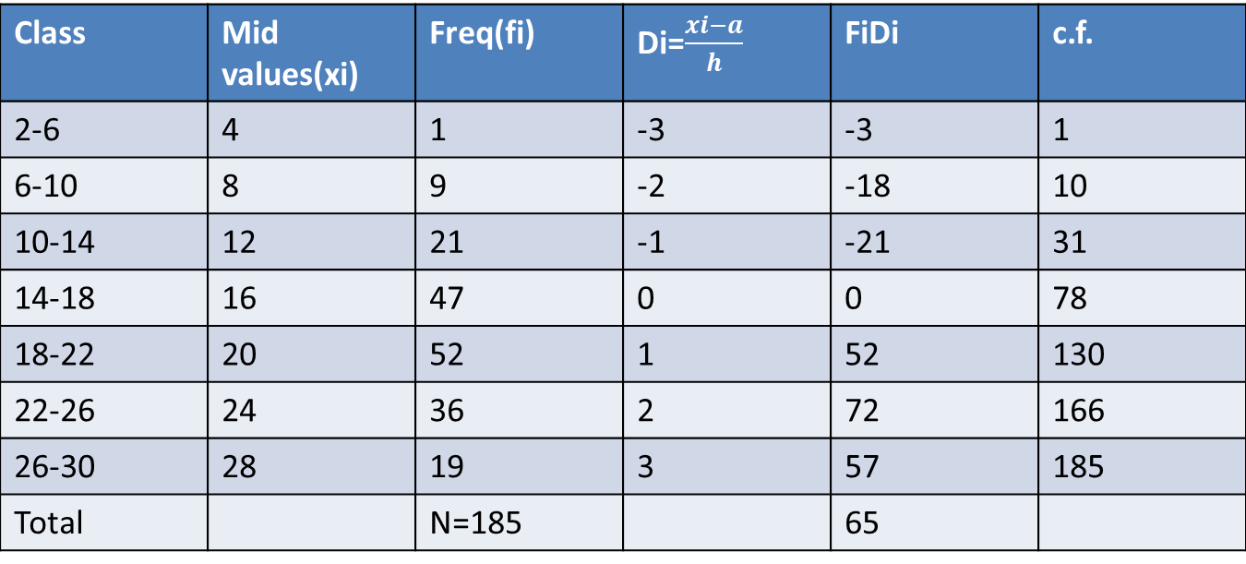
Solution
Class | Mid values(xi) | Freq(fi) | Di=$\frac{xi−a}{h}$ | FiDi | c.f.
2-6 | 4 | 1 | -3 | -3 | 1
6-10 | 8 | 9 | -2 | -18 | 10
10-14 | 12 | 21 | -1 | -21 | 31
14-18 | 16 | 47 | 0 | 0 | 78
18-22 | 20 | 52 | 1 | 52 | 130
22-26 | 24 | 36 | 2 | 72 | 166
26-30 | 28 | 19 | 3 | 57 | 185
Total |  | N=185 |  | 65

Slide 12
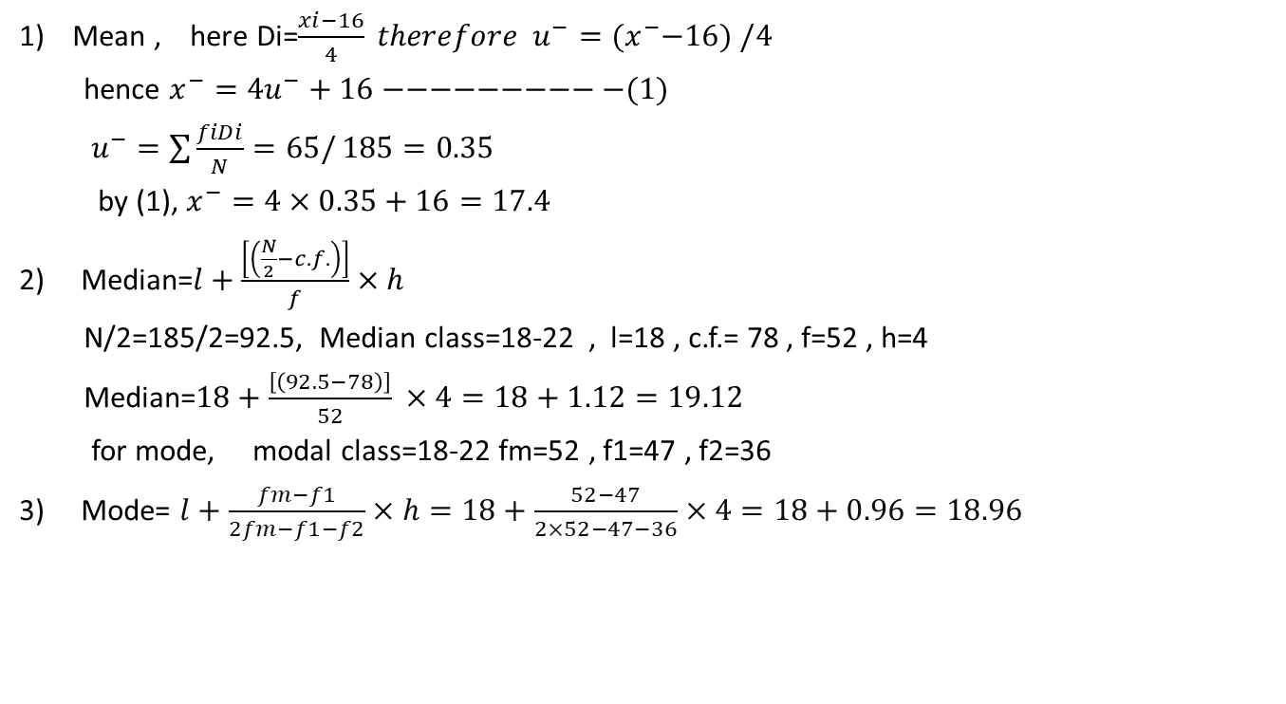
continued
Mean , here Di=$\frac{xi−16}{4} therefore u^{−}={(x}^{−}−16) /4$
hence $x^{−}=4u^{−}+16−−−−−−−−−−(1)$
$u^{−}=\sum{\frac{fiDi}{N}=65/}185=0.35$
by (1), $x^{−}=4×0.35+16=17.4$
2) Median=$l+\frac{\left[\left(\frac{N}{2}−c.f.\right)\right]}{f}×h$
N/2=185/2=92.5, Median class=18-22 , l=18 , c.f.= 78 , f=52 , h=4
Median=$18+\frac{\left[\left(92.5−78\right)\right]}{52} ×4=18+1.12=19.12$
for mode, modal class=18-22 fm=52 , f1=47 , f2=36
3) Mode= $l+\frac{fm−f1}{2fm−f1−f2}×h=18+\frac{52−47}{2×52−47−36}×4=18+0.96=18.96$

